Slide 1

^{Chapter 1} Introducing Data Structures and Algorithms
Royal University of Phnom Penh
Faculty of Engineering
Data Structures and Algorithms
Dr. Srun Sovila

Slide 2
Outline
Arrays
Ordered Arrays
The Bubble Sort
The Insertion Sort

Slide 3
Outline
Arrays
Ordered Arrays
The Bubble Sort
The Insertion Sort

Slide 4
The Running Time of a Program
There are many algorithms to solve a problem, thus how to select a good algorithm?
There are two different goals of algorithm selection:
An algorithm, which is easy to understand, code, and debug;
An algorithm, which makes efficient use of the computer’s resources, especially one that run as fast as possible.
So, how to select solution for problems?

Slide 5
Measuring Running Time of a Program
The running time of a program depends on factors such as:
the input to the program,
the quality of code generated by the compiler used to create the object program,
the nature and speed of the instructions on the machine used to execute the program, and
the time complexity of the algorithm underlying the program.
The input tells us that the running time of a program, thus time should be defined as a function of the input.

Slide 6
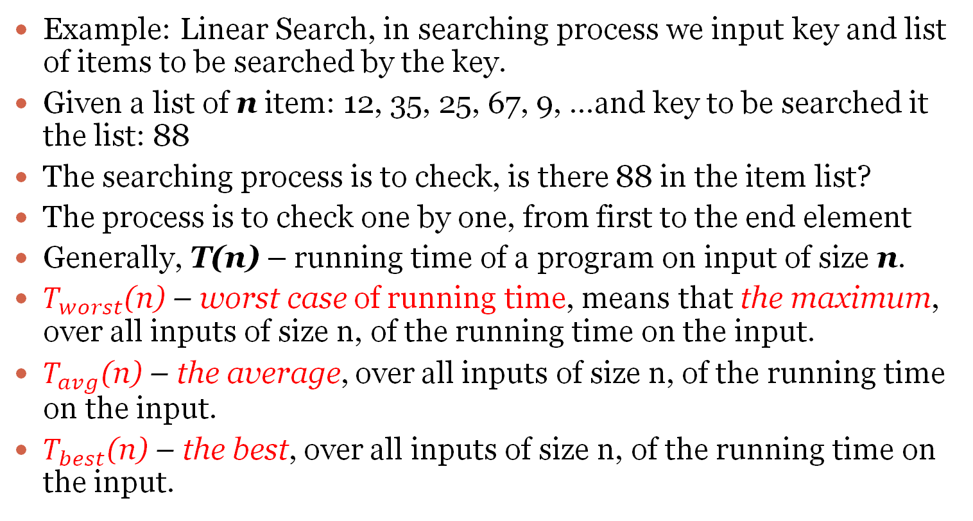
Measuring Running Time of a Program (cont.)
Example: Linear Search, in searching process we input key and list of items to be searched by the key.
Given a list of n item: 12, 35, 25, 67, 9, …and key to be searched it the list: 88
The searching process is to check, is there 88 in the item list?
The process is to check one by one, from first to the end element
Generally, T(n) – running time of a program on input of size n.
$T_{worst}$(n) – worst case of running time, means that the maximum, over all inputs of size n, of the running time on the input.
$T_{avg}$(n) – the average, over all inputs of size n, of the running time on the input.
$T_{best}$(n) – the best, over all inputs of size n, of the running time on the input.

Slide 7
Measuring Running Time of Linear Search
1
searchKey = 66; //find item with key 66 for(j = 0; j < nElems; j++) //for each element, if(arr[j] == searchKey) //found item? break; //yes, exit before end if(j == nElems) //at the end? cout << “Can’t find “ << searchKey << endl; //yes else cout << “Found “ << searchKey << endl; //no
Running time of Linear Search for this source code:
1
n+1
n
n (possible)
1
1
1 (possible)
1 (possible)
1 (possible)
3n + 78

Slide 8
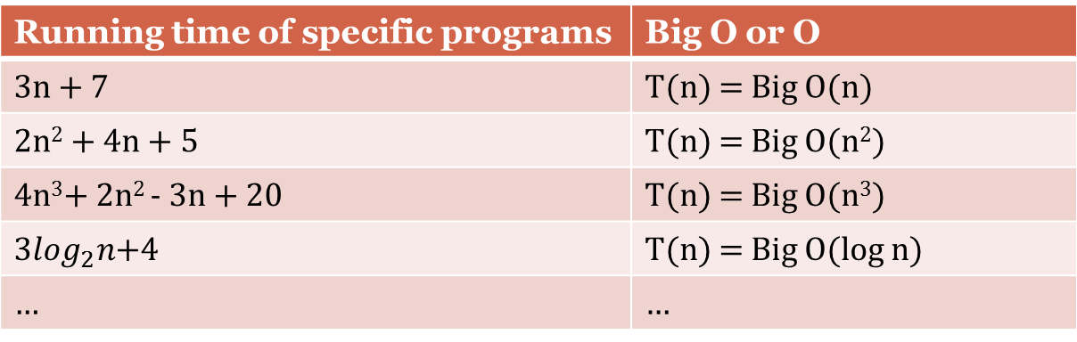
Big O Notation
In Cambodia, automobiles are divided by engine power into several categories: 1.4, 1.6, 1.8, and so on.
Similarly, efficient a computer algorithm is shortly called by Big O and kind of mathematical functions (constant, logarithmic, linear, quadric, polynomial or algebraic, exponential,…)
Running time of specific programs | Big O or O
3n + 7 | T(n) = Big O(n)
2n² + 4n + 5 | T(n) = Big O(n²)
4n³+ 2n² - 3n + 20 | T(n) = Big O(n³)
${3log}_{2}n$+4 | T(n) = Big O(log n)
… | …

Slide 9


Homework submit to: fe.assignment@gmail.com
Mon., 19-Oct.-2015
@ 15:00
What is the purpose of Big O notation?
What is the running time (Big O ) of the following codes:
Code 1 | Code 2
Sum = 0; QuadricSum = 0; for( i=0; i < n; i++ ){ Sum += i; QuadricSum += i*i; } cout << “Sum = “ << Sum << endl; cout << “Quadric Sum = “ << QuadricSum << endl; | Multiply = 1; for( i = 1; i < n; i++) for( j = 1; j < n; j++ ) if( i != j ) Multiply += i*j; cout << “Multiply= “ << Multiply;

Slide 10
To be continued…

